Slide 1
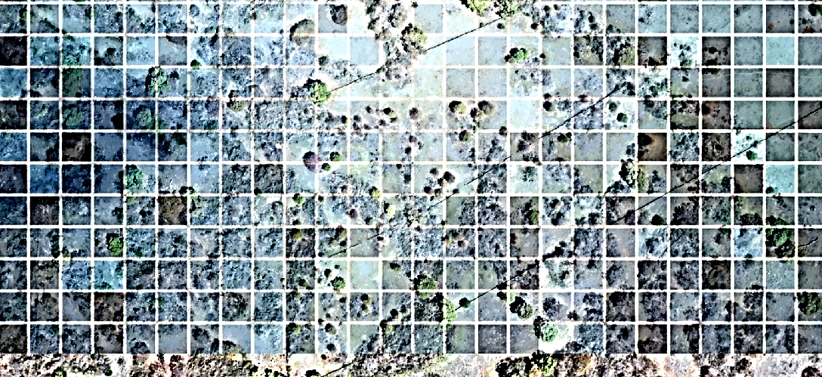


























Understanding the Basics: Woodfuel Supply and Demand Dynamics Capacity Building Workshop for BeZero
London, February 11th & 12th 2025
Webpage: https://wegp.unam.mx/courses/BeZero2025 Google Meet: https://meet.google.com/ocj-yzur-uws

Slide 2
BeZero’s questions in this presentation
Should projects be claiming credits for sequestration?
fNRB for households which rely mainly on harvest residue e.g. they have no impact on forest dynamics?
fNRB for households which don't disclose household locations?
How can you know where fuel is sourced from?
What is the fNRB accuracy for commodity-based fuels like charcoal?
Explanation of BURN fNRB method and differences to MoFuSS?
Tracking differences in fNRB overtime to enhance ratings robustness?
Should fNRB decrease each year if project is effective?

Slide 3
Outline
Relevance & motivating questions
Background: Basics of dynamic woodfuel mapping

Slide 4


Woodfuels
1. Relevance & motivating questions
Fuelwood or Firewood
Charcoal

Slide 5
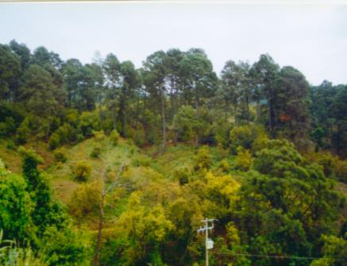
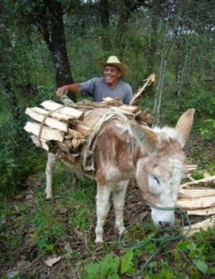
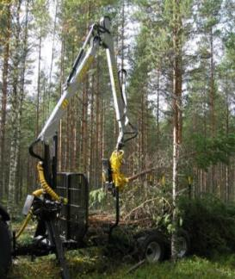
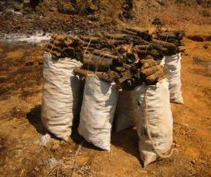
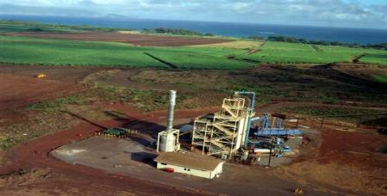
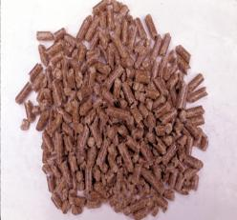
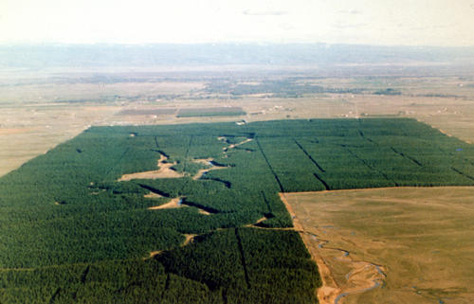
Two worlds of solid biomass energy
1. Relevance & motivating questions
Traditional
Modern

Slide 6


Two worlds of solid biomass energy
1. Relevance & motivating questions
Traditional
Modern

Slide 7
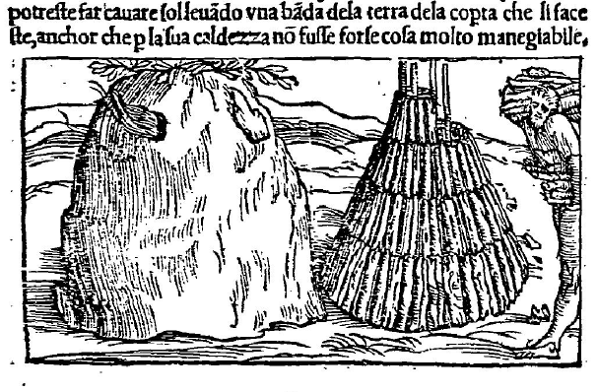
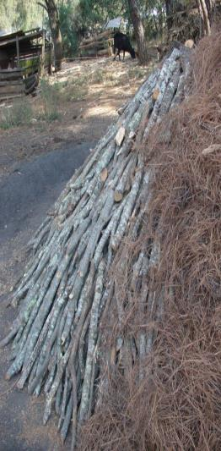
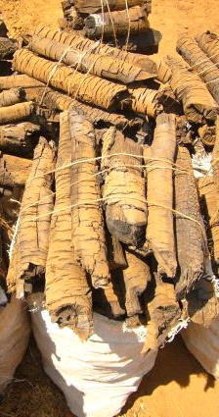

Traditional charcoal making
1. Relevance & motivating questions
Siena, 16th century
Mexico, 2019
De la Pirotechnia, Vanoccio Biringuccio, 1540

Slide 8
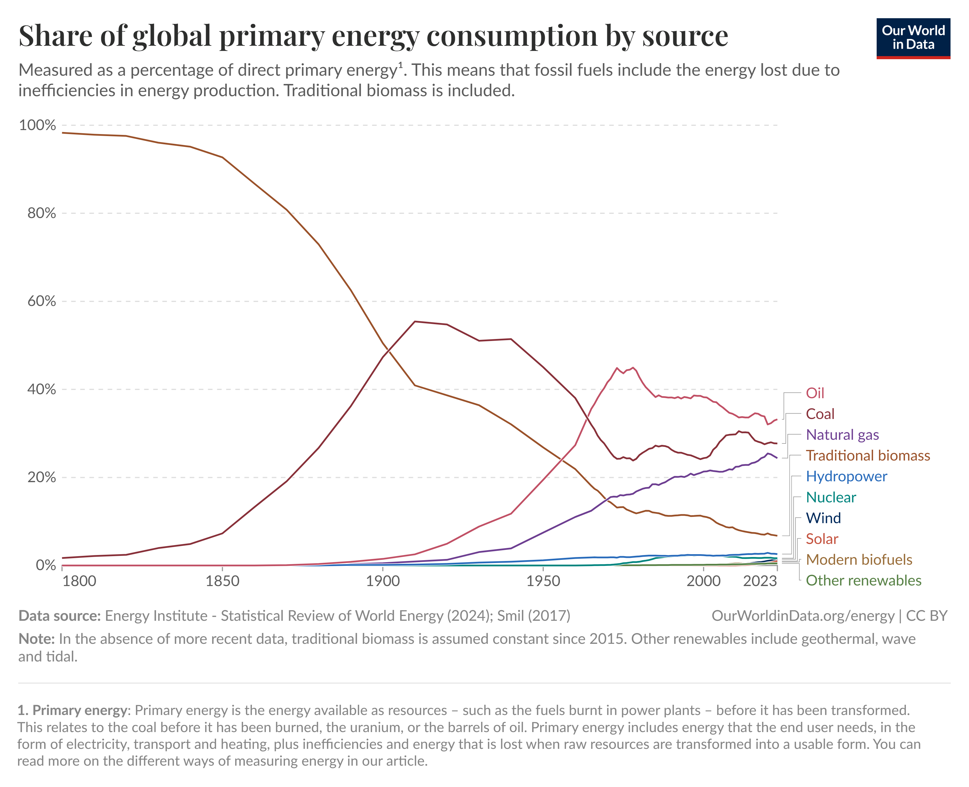

Slide 9
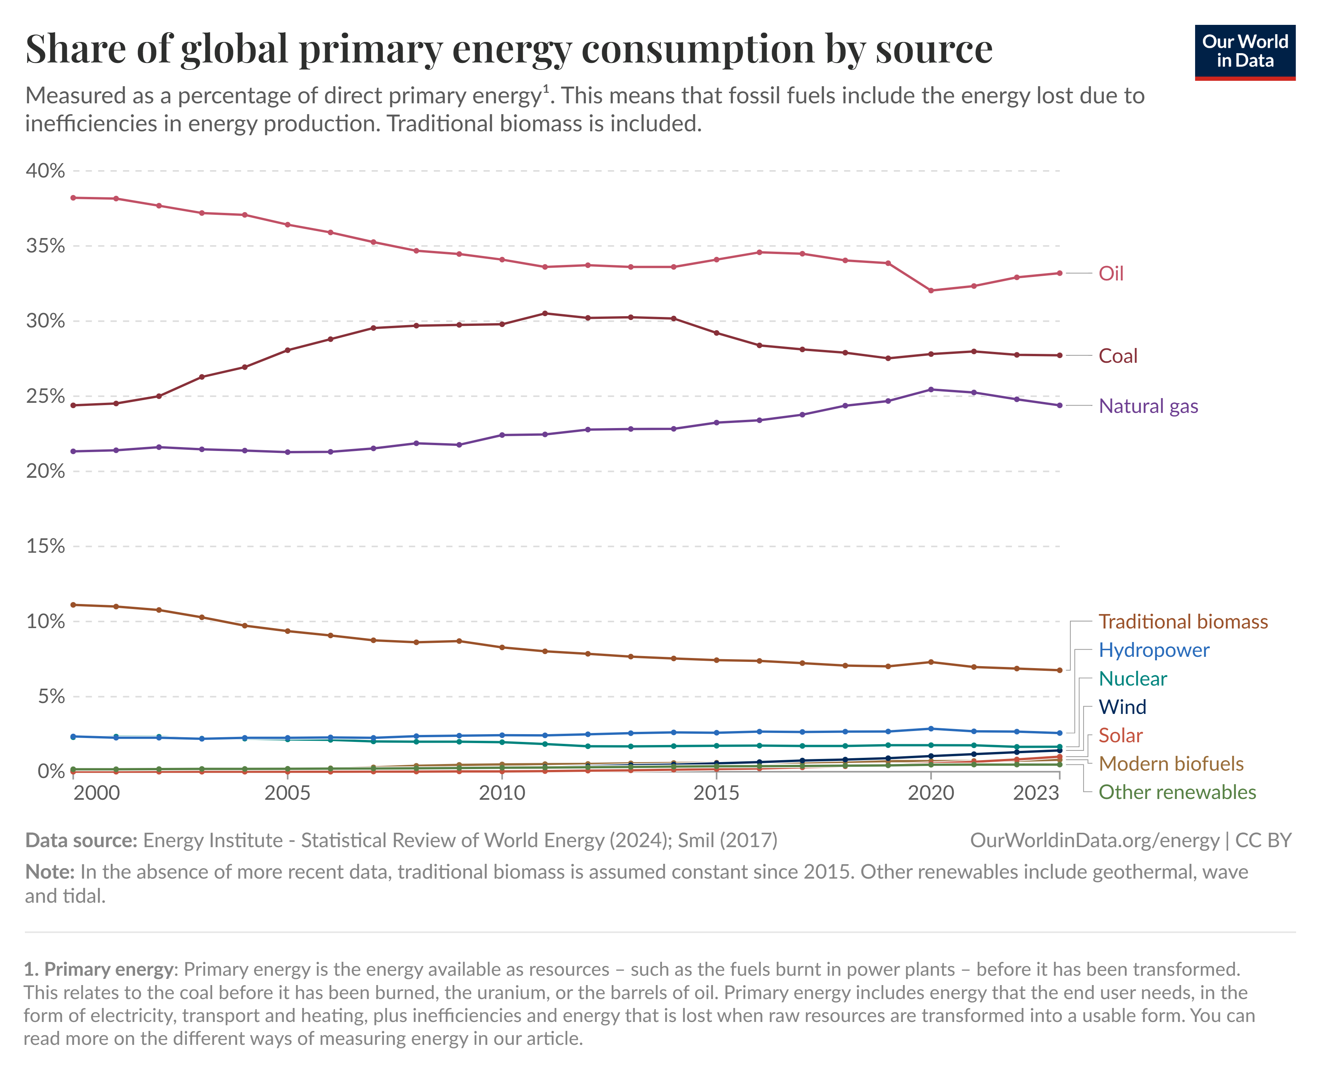

Slide 10
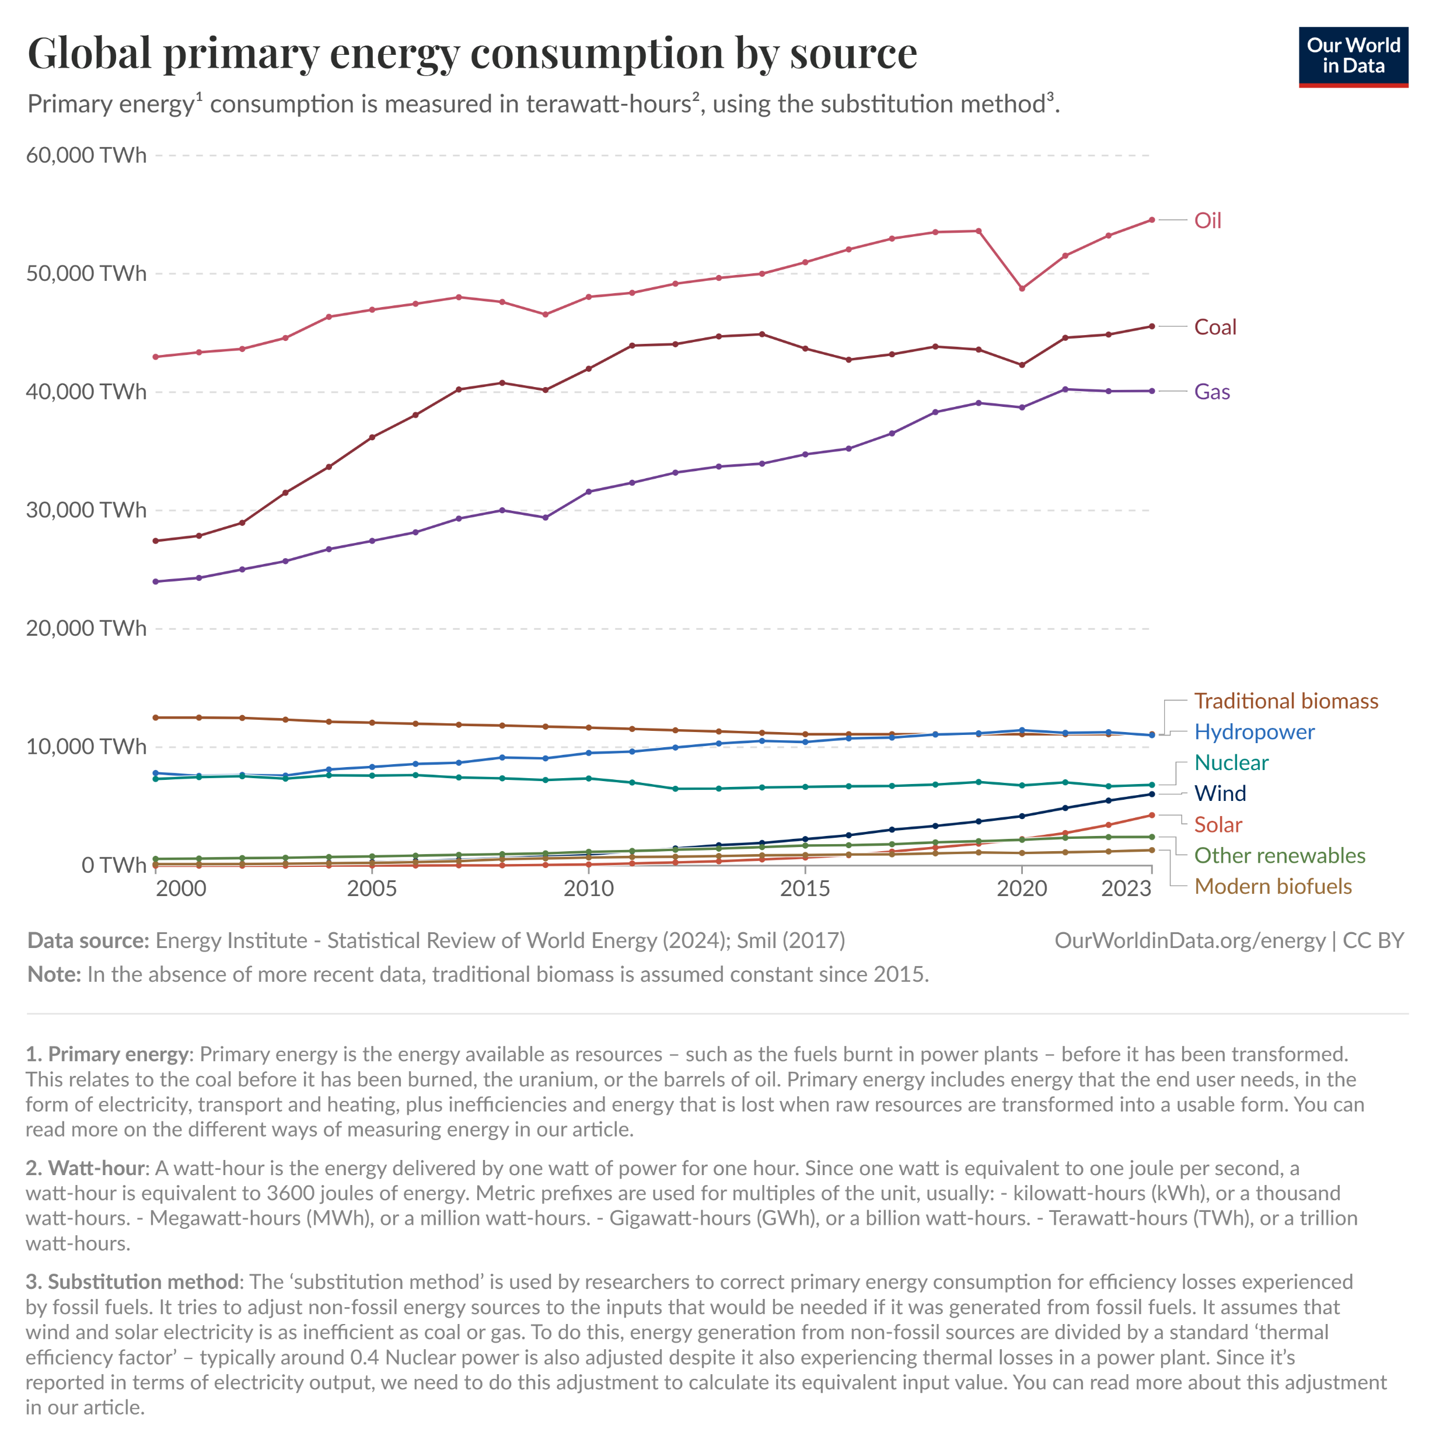

Slide 11
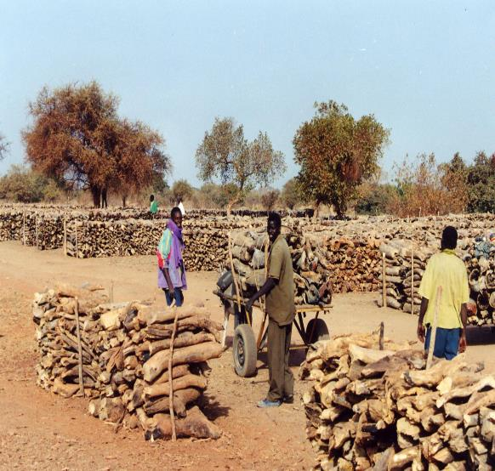
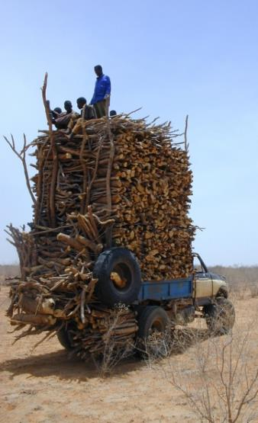
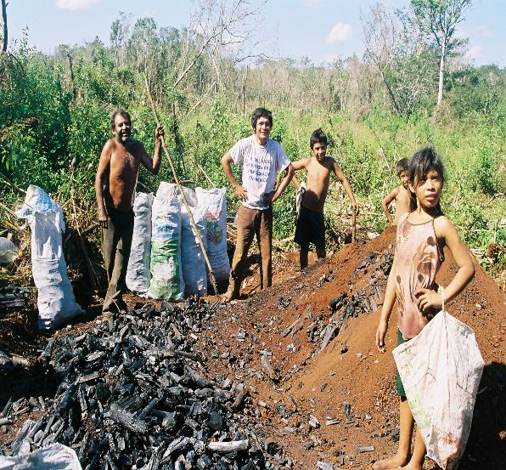

How many people use/depend on traditional woodfuels?
1. Relevance & motivating questions
Use and depend are quite different concepts.
Between 20% to 30% of the global population relies on traditional woodfuels for satisfying their daily residential energy needs.

Slide 12
Traditional woodfuel consumption in 2009
1. Relevance & motivating questions
Bailis, Drigo, Ghilardi, Masera, Nature Climate Change 2015.

Slide 13

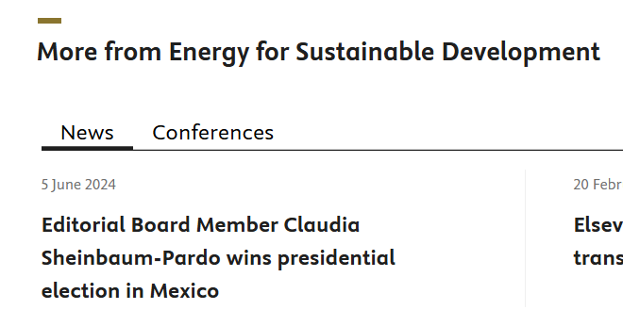
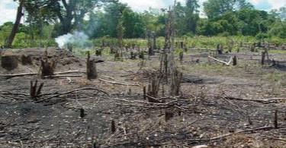
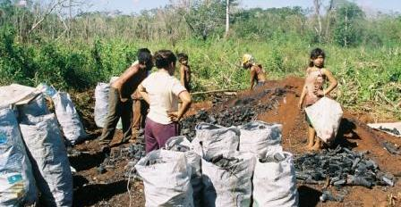

What are the socio-environmental impacts?
1. Relevance & motivating questions
Forest degradation
Poverty
Health & Risks
Any Benefits ?
CO₂ emissions
Biodiversity loss
Genetic erosion
Water infiltration
Altered fires regimes
Topsoil sterilization
Incidences of pests
Ilegal or unregulated
Entangled supply chains
Perverse incentives
End-users affordability of alternative fuels
...
Morbility due to Indoor Air Pollution
Chronic obstructive pulmonary disease
Accidents
Child labor
…

Slide 14
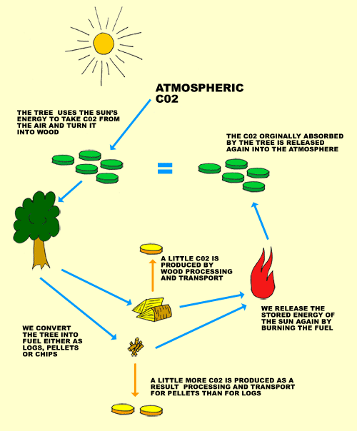
“…in terms of biomass” – due to an emphasis in climate change over local environment and health
1. Relevance & motivating questions
CH4, CO, NOx, TNMHC, BC
Non-renewable
Notes:
Climate, local environment, health
A 100 años
CH4: 21
CO: 3
NOx: 296
TNMHC: 11

Slide 15
“…in terms of biomass” – due to an emphasis in climate change over local environment and health
1. Relevance & motivating questions
Renewable
PIC
Notes:
A 100 años
CH4: 21
CO: 3
NOx: 296
TNMHC: 11

Slide 16
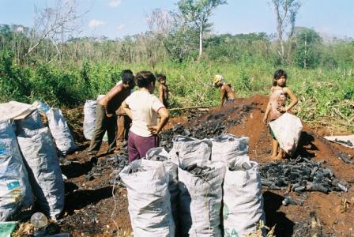
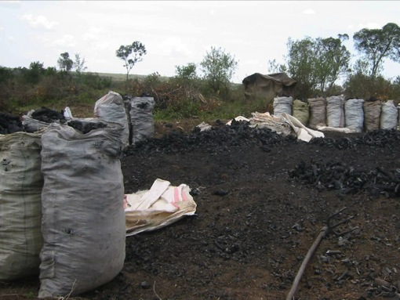
Motivating questions
1. Relevance & motivating questions
Under what conditions is woodfuel exploitation sustainable?
Can we quantify sustainability in this context?
Can efficient cookstoves (or fuel switching) reduce deforestation and forest degradation?

Slide 17
Woodfuel’s impacts, …a selection of old references
1. Relevance & motivating questions
…the other energy crisis (Eckholm, 1975)
…a major driver of environmental degradation (de Montalembert & Clement, 1983).
…seldom create problems of such a magnitude…so as to require major interventions…(Arnold, et. Al, 2006)
…causing severe deforestation (e.g. Singh, et al., 2010) …or habitat degradation (e.g. Ahrends, et al., 2010; Ryan, et al., 2012).
…have very limited impact (e.g. Hansfort & Mertz, 2011)
…repeated sampling over a period of 7 years revealed a stable supply of wood from harvesting areas (e.g. Swemmer, 2018)

Slide 18
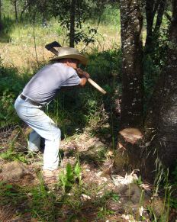
We might sum up current understanding this way…
1. Relevance & motivating questions
In certain areas and under certain conditions, woodfuel exploitation can contribute to deforestation and forest degradation
Notes:
…and when woodfuel use does contribute to deforestation and/or degradation, it is rarely the sole contributor (Geist and Lambin, 2002; Kaimowitz and Angelsen, 1998)

Slide 19
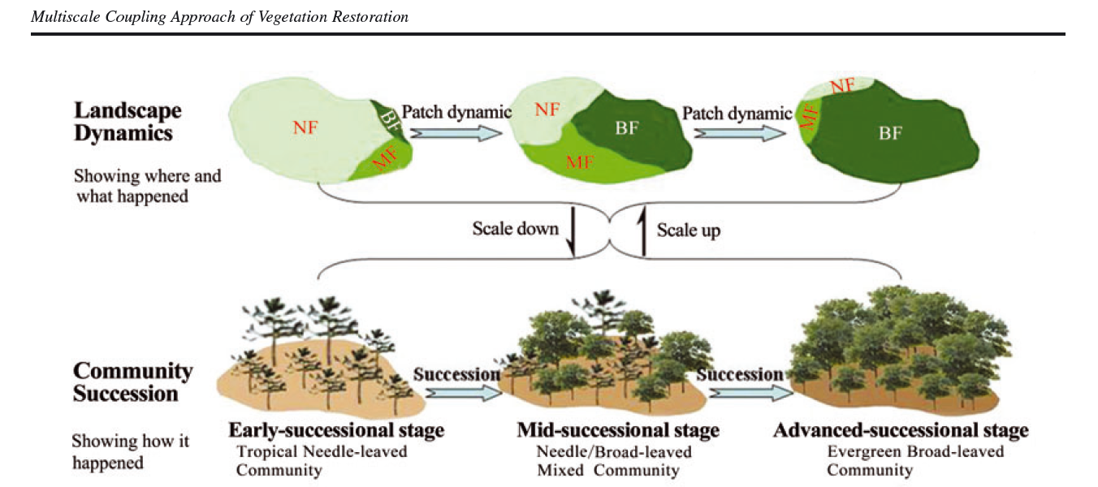
Landscapes, where human-environment interactions occur, are inherently dynamic
2. Background: Basics of dynamic woodfuel mapping

Slide 20
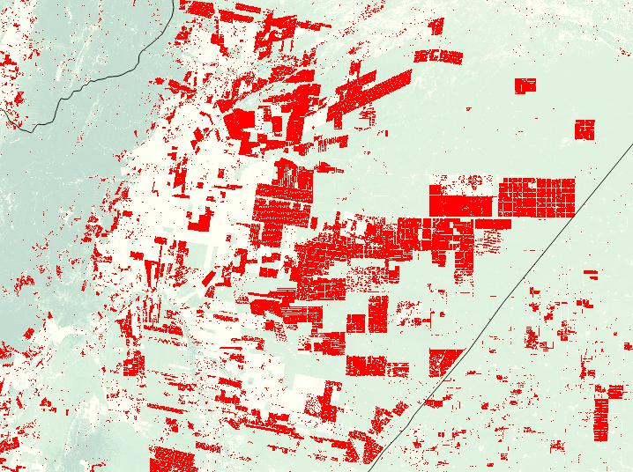
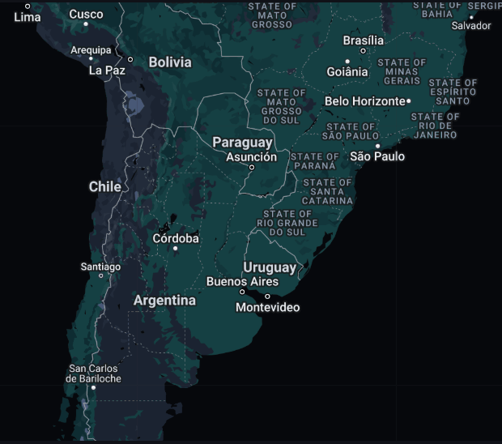
Deforestation Events
2000 -> 2012

Slide 21
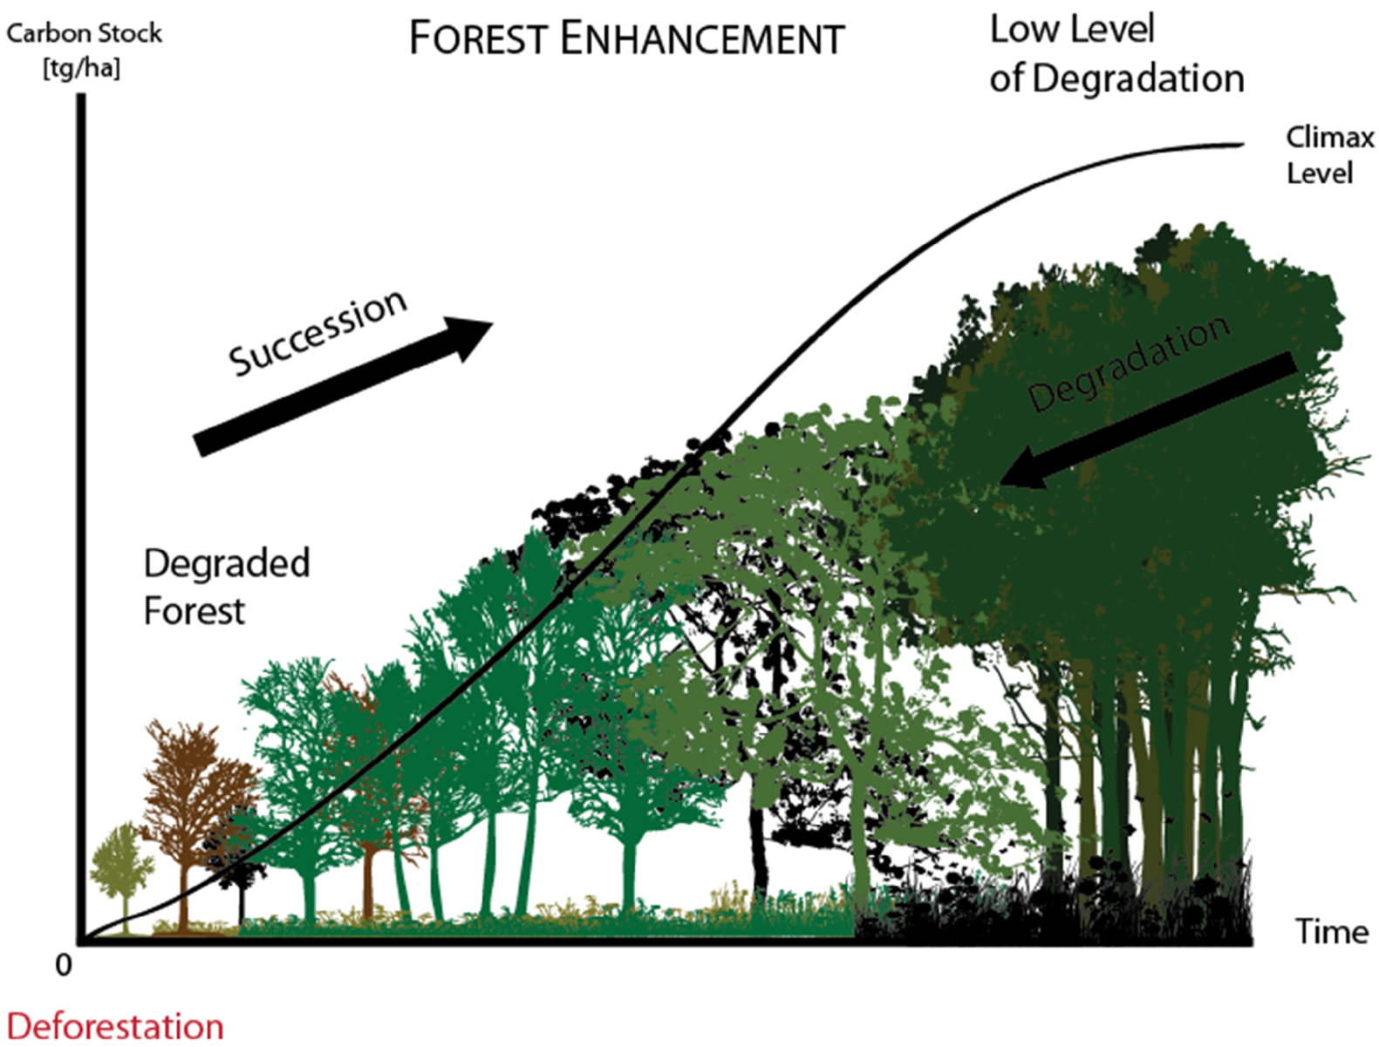

Some man-made changes are not evident “from above”
2. Background: Basics of dynamic woodfuel mapping
Morales, Skutsch, Pelaez, Ghilardi, et al 2014

Slide 22
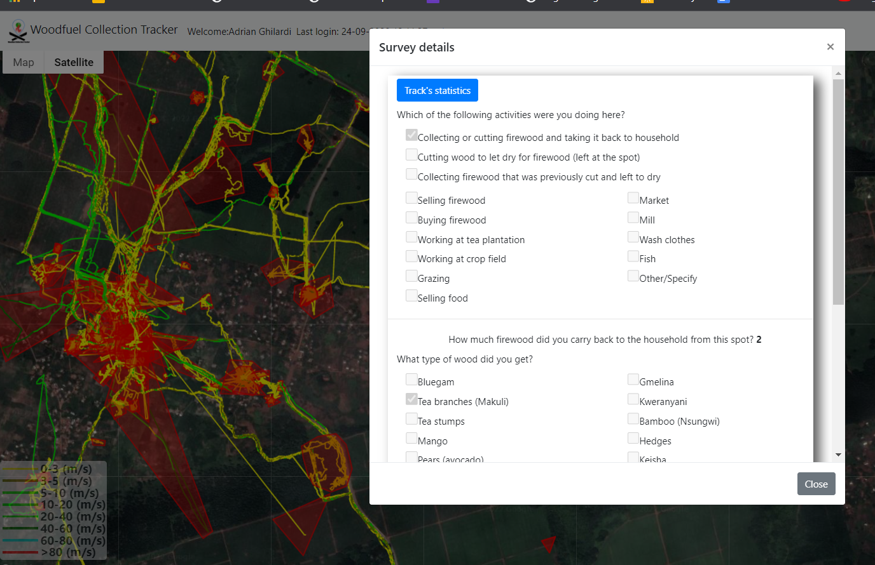
Wood collection is always intermingled with other activities
2. Background: Basics of dynamic woodfuel mapping
SMALL SCALE AGRICULTURE
TRADITIONAL FUELWOOD
TRADITIONAL CHARCOAL
EXTENSIVE GRAZING
?
ALTERED FIRE REGIMES
Peng et al 2020

Slide 23
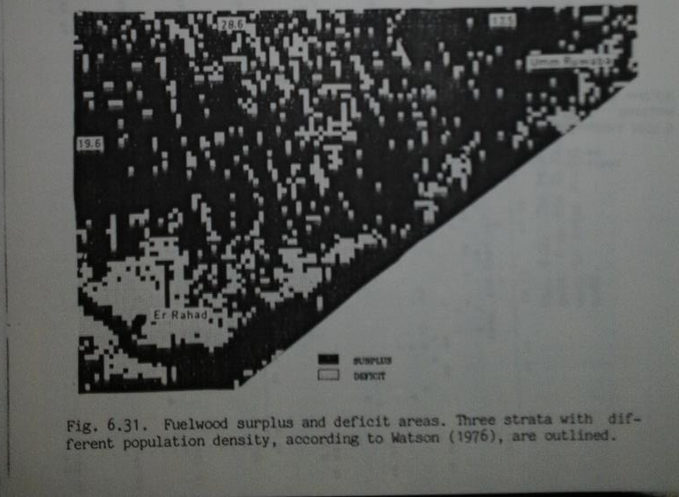
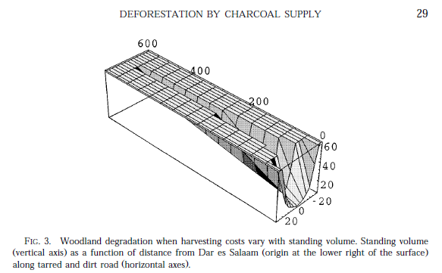
First landscape level studies
2. Background: Basics of dynamic woodfuel mapping
Spatial
Temporal
Olson, PhD Thesis Lund University 1985
Hofstad, J. Environ. Econ. Manag 1997

Slide 24
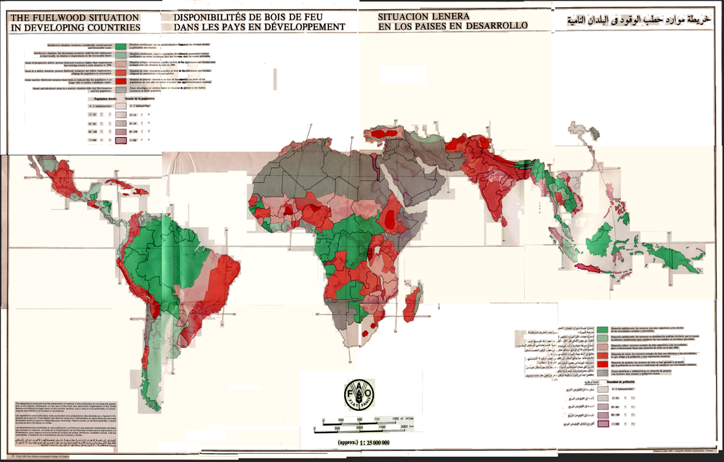
FAO, 1981; Drigo 2006; Ghilardi 2007.

Slide 25
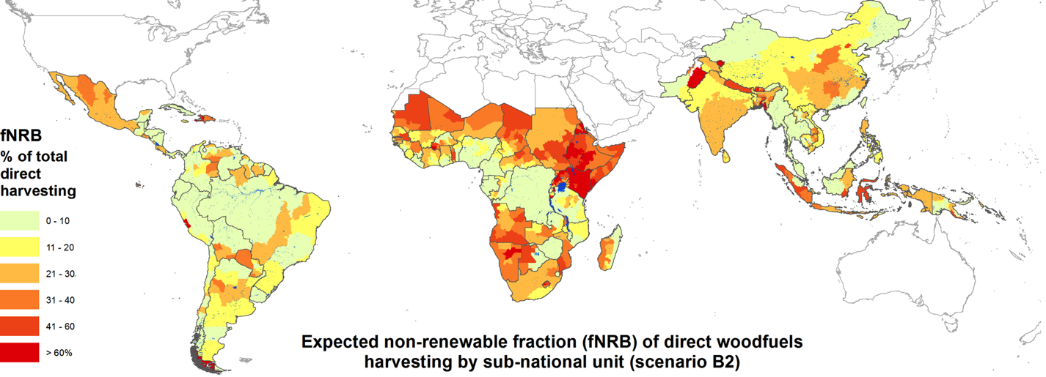
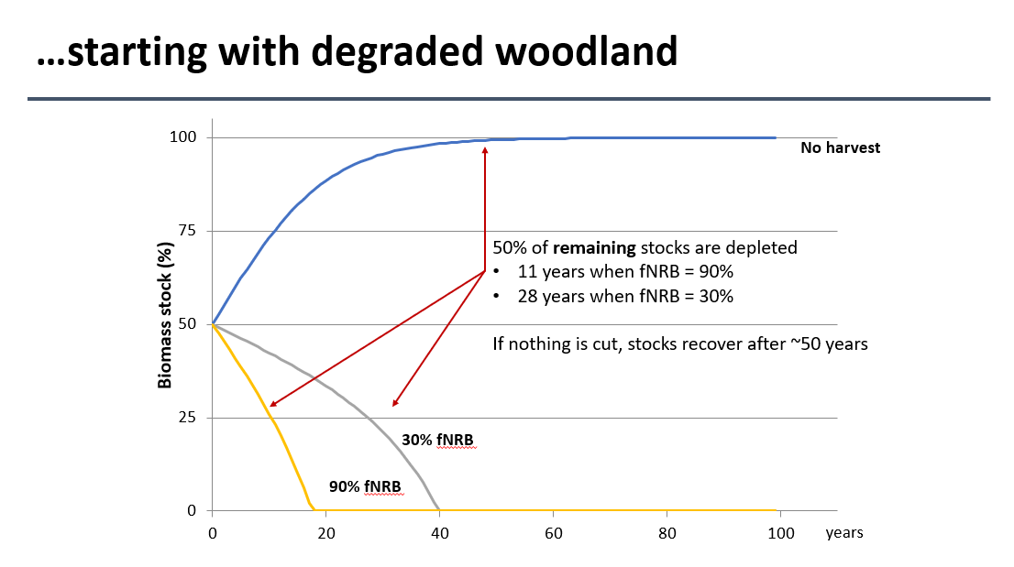
Results of a recent global assessment (circa 2009)
2. Background: Basics of dynamic woodfuel mapping
fNRB = NRB ÷ Consumption
Global fNRB ~30%
Net emissions are 1.0-1.2 GtCO₂e
Hotspots: fNRB ~50% in E Africa, S Asia
Bailis, Drigo, Ghilardi, Masera, Nature Climate Change 2015.

Slide 26
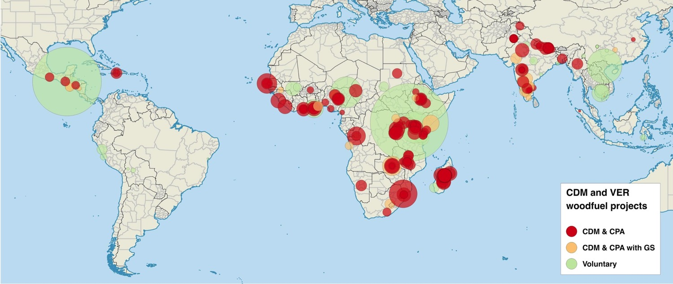

Project developers have assumed fNRB is very high
2. Background: Basics of dynamic woodfuel mapping
Global median fNRB of 287 cookstove projects is nearly 90%
Bailis, Wang et al, 2017 2015.

Slide 27
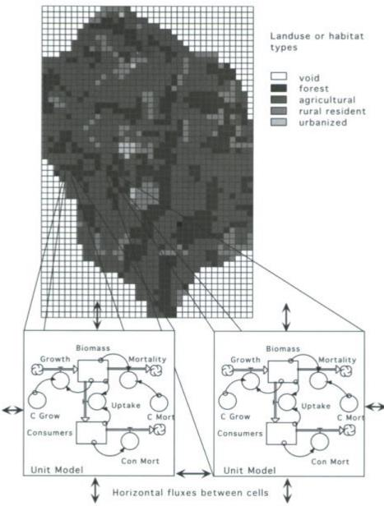
How to include spatial dynamics in woodfuel supply-demand analyses?
Constanza & Voinov 2004

Slide 28
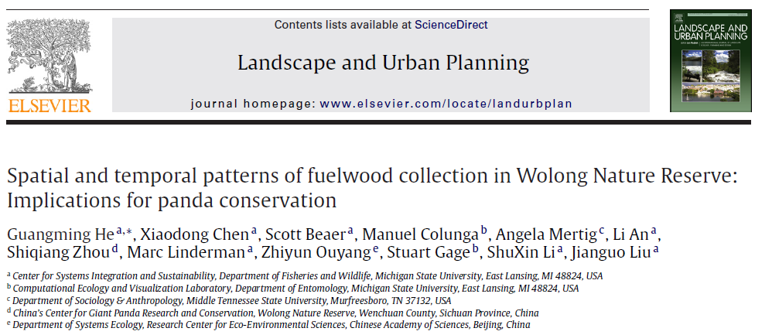

Way fewer attemps have been spatio-temporal

Slide 29
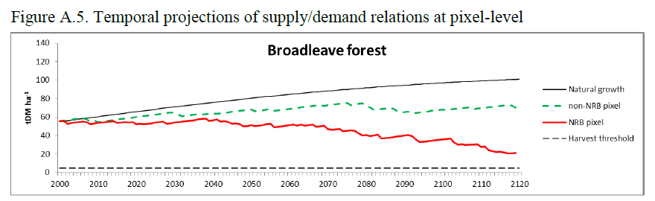
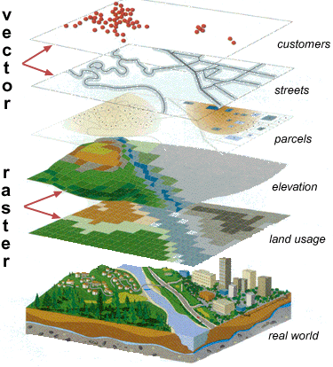
Spatial and temporal scales can affect simulations outcomes
Spatial and temporal scale affects the frequency and intensity by which raster cells are harvested.
And this has implication on the modeled response of the vegetation to the disturb.
Fine temporal resolution
t1
t2
t3
t4
Coarser temporal resolution

Slide 30
MoFuSS: year or week / 1km or 100m
Example of response of vegetation to fuelwood extracion at pixel level
Example of response of vegetation to fuelwood extracion at landscape level

Slide 31
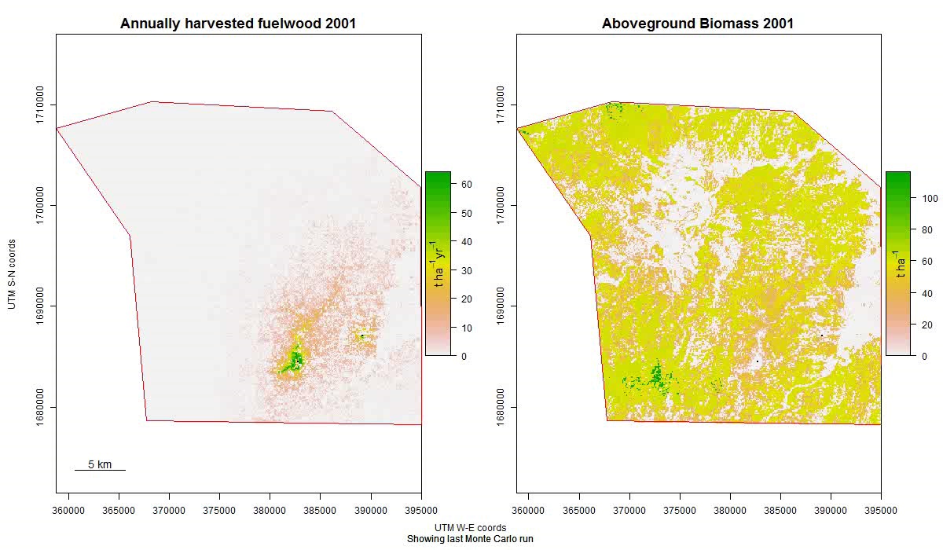

Slide 32
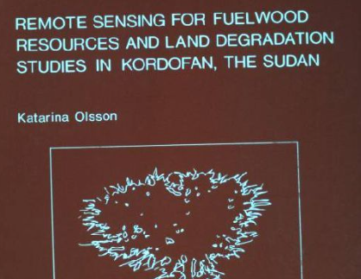

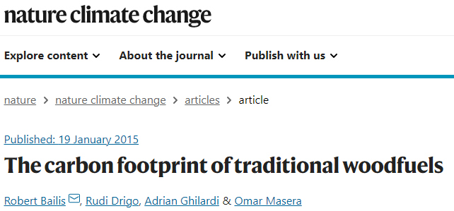

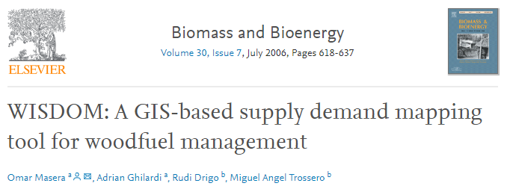
A History of Woodfuel Supply-Demand Modeling (1979–2025)
1985
Before 2000: Spatial supply/demand analyses
2000-2006 WISDOM core development
2015 Global estimates using WISDOM + MoFuSS algorithms for harvest maps
2020-2021 Hiatus (all MoFuSS development halted)
2022 Proposal for updating Global fNRB estimates using MoFuSS
2011-2015 MoFuSS core development
Drigo et al 2002

