Slide 1
Generating Emission Reductions from Clean Cooking Interventions
Rob Bail is – SEI US
Adrian Ghilardi – UNAM
Stephen Pluymaekers – CCA
Dana Charon – Berkeley Air Monitoring Group
MoFuSS 2025 BeZero Workshop
Tuesday 05 November 2024

Slide 2
What’s all the fuss about?
Today, about 2.3 billion people rely on woodfuels☨ for their energy needs (WHO)
Top risk factor for illness and death
2.6 million deaths in LMICs in 2021 (IHME) ✧
1-2% of global climate-forcing ❊
Large burden on household labor & budget
Largest source demand for woody biomass
50% of “roundwood” harvest burned as fuel (FAO)
Potentially large driver of degradation (see appendix)
Woodfuels as primary cooking fuel (2020 & 2050)
The no. of woodfuel users in SSA is projected to grow by 450 million by 2050
billions of people
* Woodfuels include unprocessed firewood, charcoal, and processed fuels like wood pellets
✧ More than Malaria, Tb, and HIV/AIDS combined
❊ Own calculations using methods described in Floess et al with updated inputs
☨ From WHO’s Household Air Pollution database
Notes:
What are NBS? (from Nature-based Solutions Initiative at Oxford)
Nature-based Solutions involve working with nature to address societal challenges, supporting human well-being and biodiversity locally. They include the protection, restoration or management of natural and semi-natural ecosystems; the sustainable management of aquatic systems and working lands; and integration of nature in and around our cities.
Malaria 0.75 M
Tb 1.2 M
HIV/AIDS 0.5 M
Total 2.5 M

Slide 3
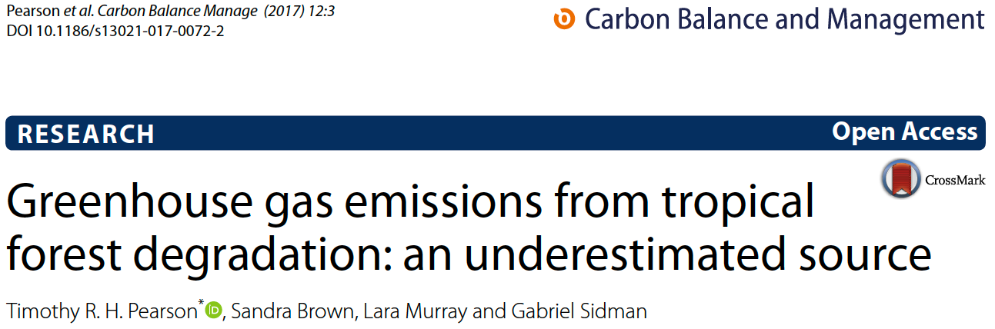
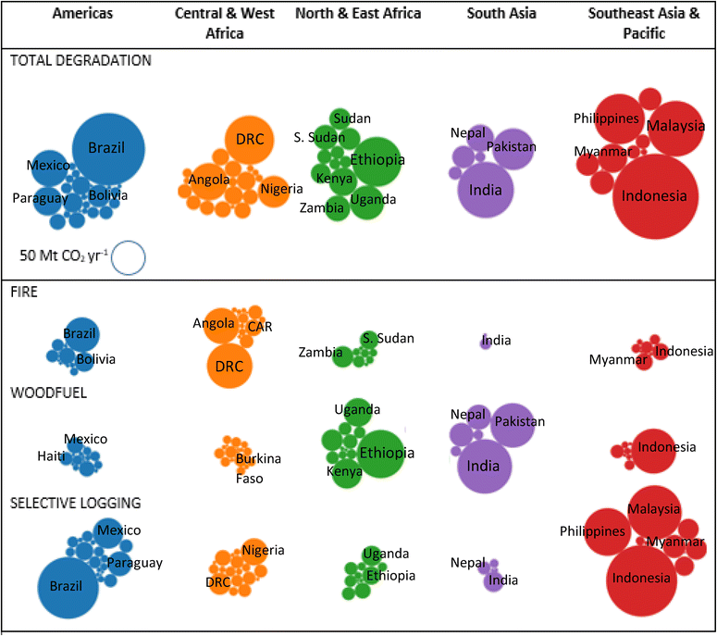
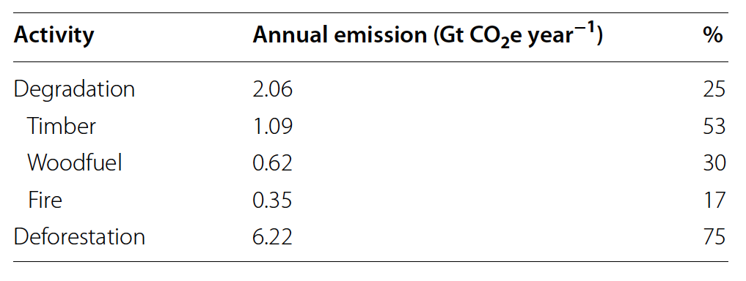
How much degradation?
Bubble chart showing degradation emissions by region (the bubble size represents the relative magnitude of emissions)
From Pearson et al. (2017)
Woodfuels are the dominant driver of degradation in E Africa and S Asia
Notes:
This estimate is about 1.1% -- only considers LULUCF, not forcing from PICs

Slide 4
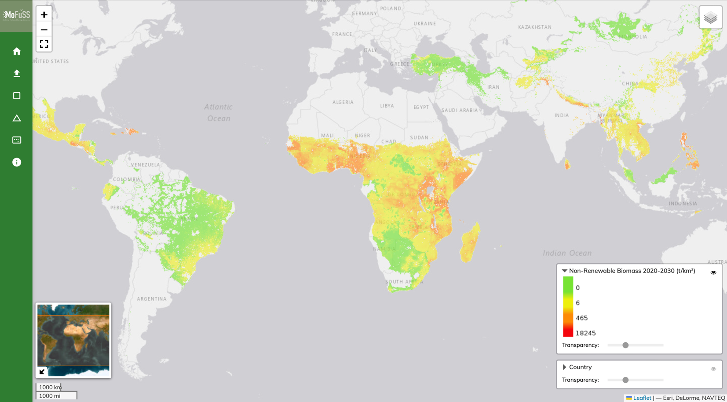
MoFuSS: projecting changes in tree cover (2020-2030) *
~ 390 ± 11 million tons of wood are lost annually
Resulting in net emissions of ~0.7 Gt CO₂ / year
*Modeling Fuelwood Savings Scenarios -- explore and download results at https://www.mofuss.unam.mx/mofuss-ds/

Slide 5
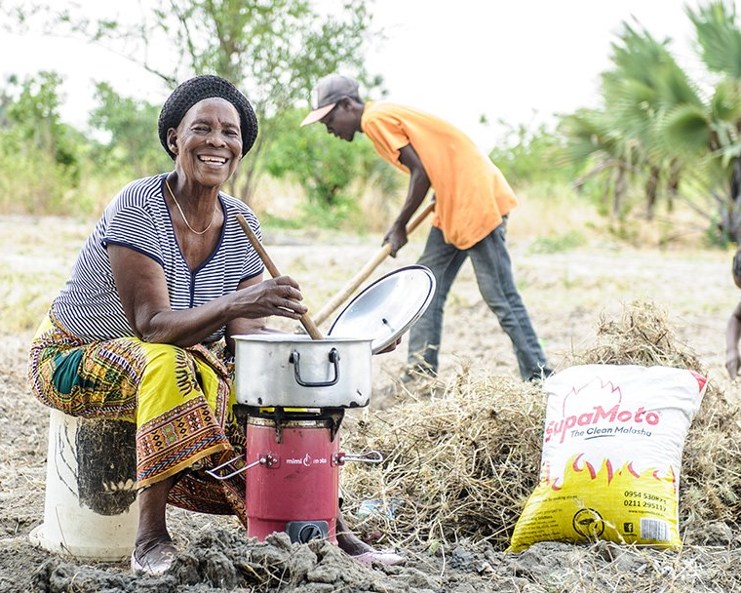
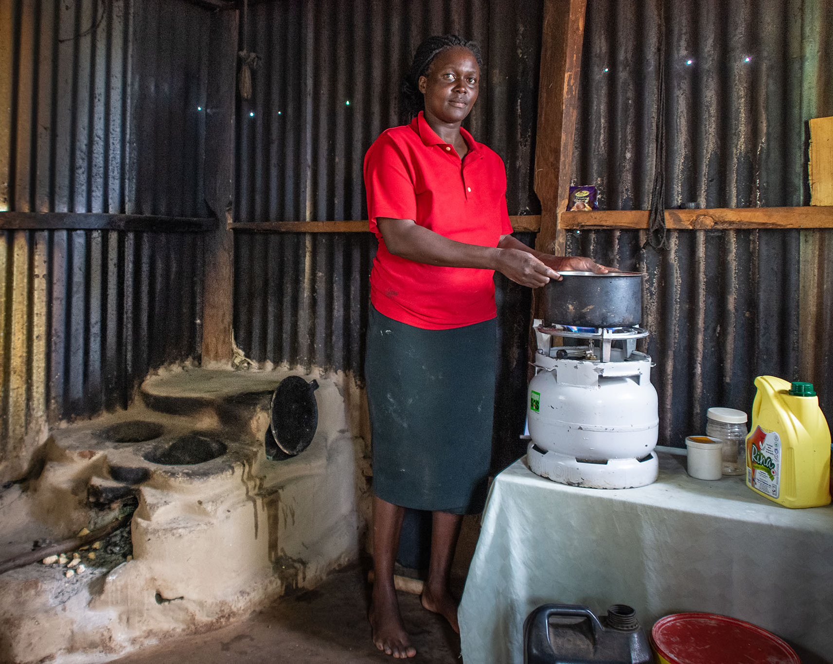
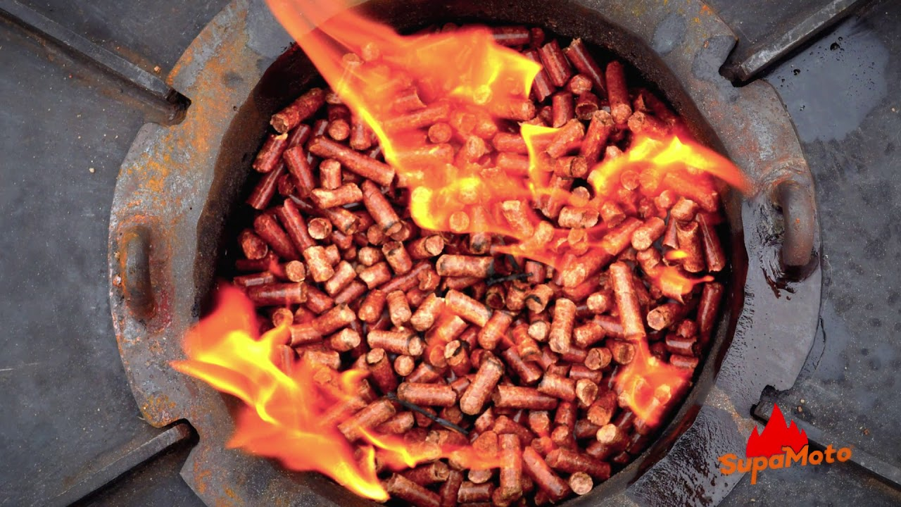
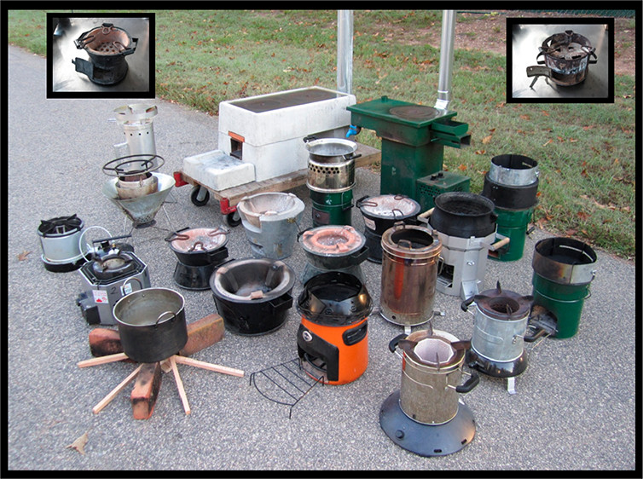


Interventions attempt to reduce woodfuel demand by:
…promoting alternative fuels
Engineered solid fuels
LPG
…introducing efficient wood and charcoal stoves
E-cooking
Ethanol

Slide 6

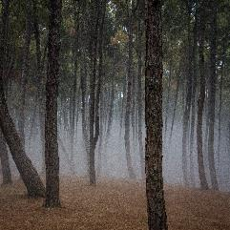

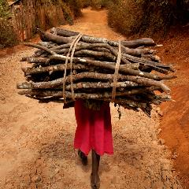
Carbon flows in the woodfuel life-cycle
Biomass growth
CO₂
Harvesting
Adapted from Forrest Robinette - CCA
Notes:
Here its worth stopping for a second for a brief tutorial on biomass and climate impacts. Start on the upper left…

Slide 7
Carbon flows in the woodfuel life-cycle
Biomass growth
CO₂
Harvesting
Physical labour, drudgery,
land cover change(?)
Livelihoods, Income
Adapted from Forrest Robinette - CCA
Notes:
Here its worth stopping for a second for a brief tutorial on biomass and climate impacts. Start on the upper left…

Slide 8
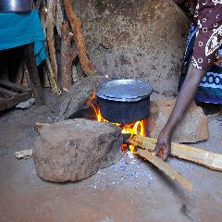
Carbon flows in the woodfuel life-cycle
Biomass growth
CO₂
Harvesting
Physical labour, drudgery,
land cover change(?)
Livelihoods, Income
Biomass burning
(for charcoal there’s also pyrolisis and transport with additional emissions)
Adapted from Forrest Robinette - CCA
Notes:
Here its worth stopping for a second for a brief tutorial on biomass and climate impacts. Start on the upper left…

Slide 9
Carbon flows in the woodfuel life-cycle
Biomass growth
CO₂
CO₂
Climate impacts
Complete combustion
Harvesting
Physical labour, drudgery,
land cover change(?)
Livelihoods, Income
Biomass burning
(for charcoal there’s also pyrolisis and transport with additional emissions)
Energy services (cooked food, heat, etc)
Adapted from Forrest Robinette - CCA
Notes:
Here its worth stopping for a second for a brief tutorial on biomass and climate impacts. Start on the upper left…

Slide 10
Carbon flows in the woodfuel life-cycle
Biomass growth
CO₂
CO₂
Health & more climate impacts
Climate impacts
Complete combustion
Harvesting
Physical labour, drudgery,
land cover change(?)
Livelihoods, Income
Incomplete combustion
CH₄, PM, BC & OC, CO, N₂O, NO_{x} NMHCs…
Biomass burning
(for charcoal there’s also pyrolisis and transport with additional emissions)
Energy services (cooked food, heat, etc)
Adapted from Forrest Robinette - CCA
Notes:
Here its worth stopping for a second for a brief tutorial on biomass and climate impacts. Start on the upper left…

Slide 11
Carbon flows in the woodfuel life-cycle
Biomass growth
Some CO₂ is stored by new plants and trees
CO₂
Some CO₂ remains in the atmosphere
CO₂
CO₂ Seq
Net CO₂
Two paths to climate impacts
Health & climate impacts
Climate impacts
Complete combustion
Harvesting
Physical labour, drudgery,
land cover change(?)
Livelihoods, Income
Incomplete combustion
CH₄, PM, BC & OC, CO, N₂O, NO_{x} NMHCs…
Biomass burning
(for charcoal there’s also pyrolisis with additional emissions)
Energy services (cooked food, heat, etc)
Adapted from Forrest Robinette - CCA
Notes:
Here its worth stopping for a second for a brief tutorial on biomass and climate impacts. Start on the upper left…

Slide 12
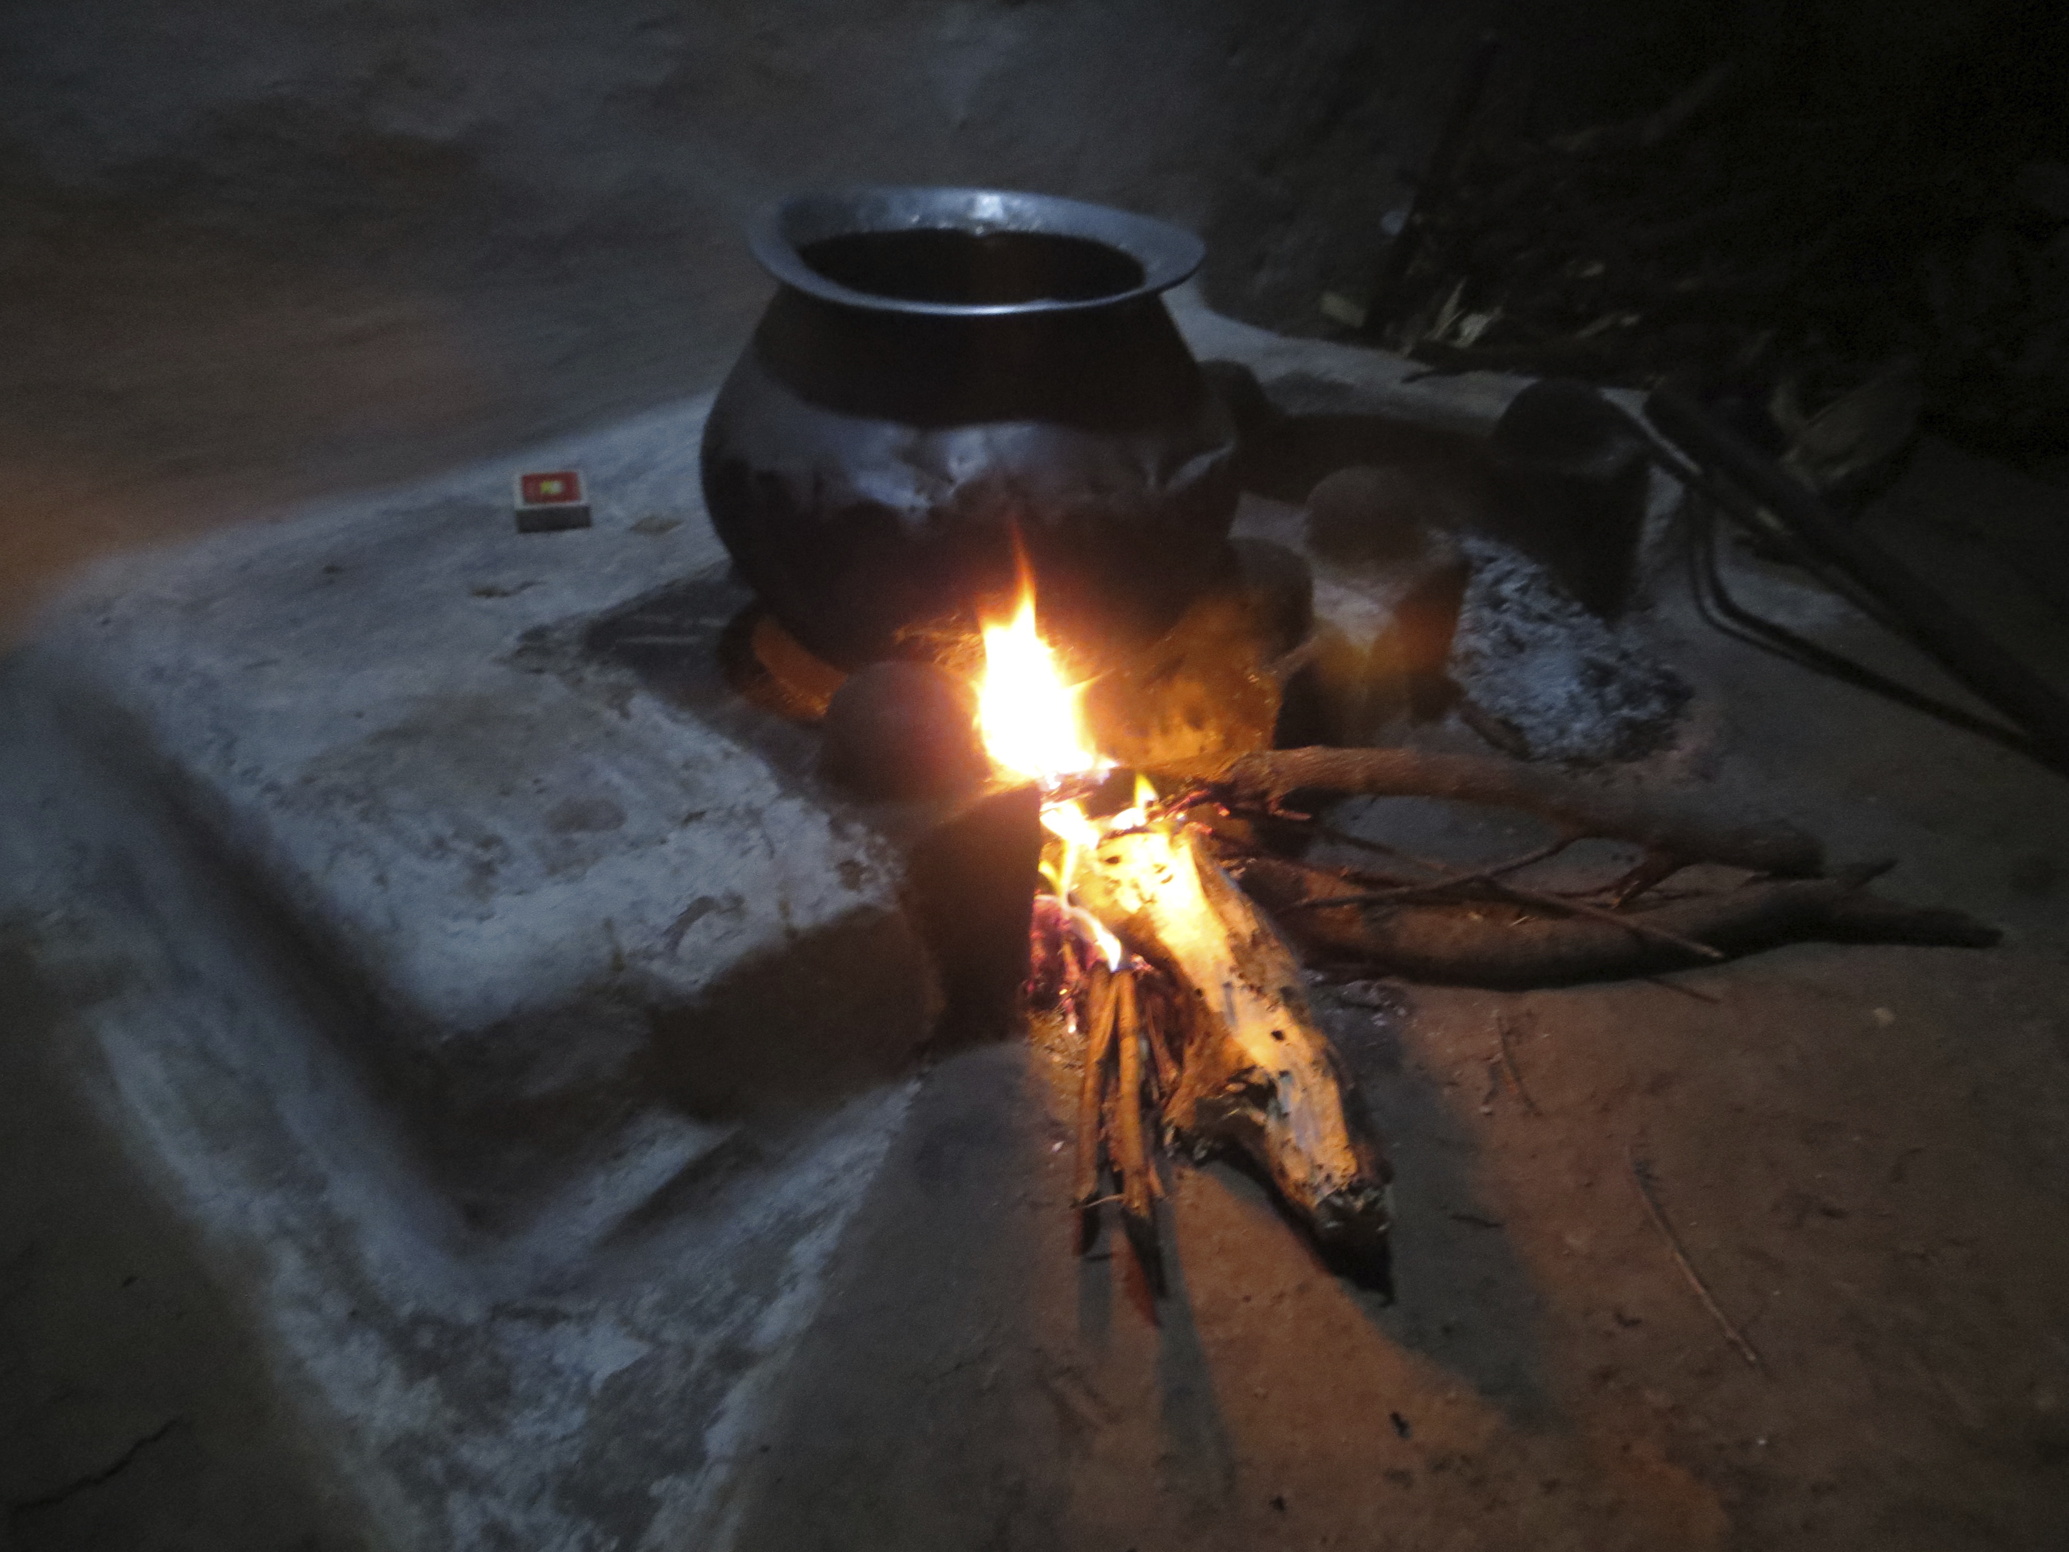
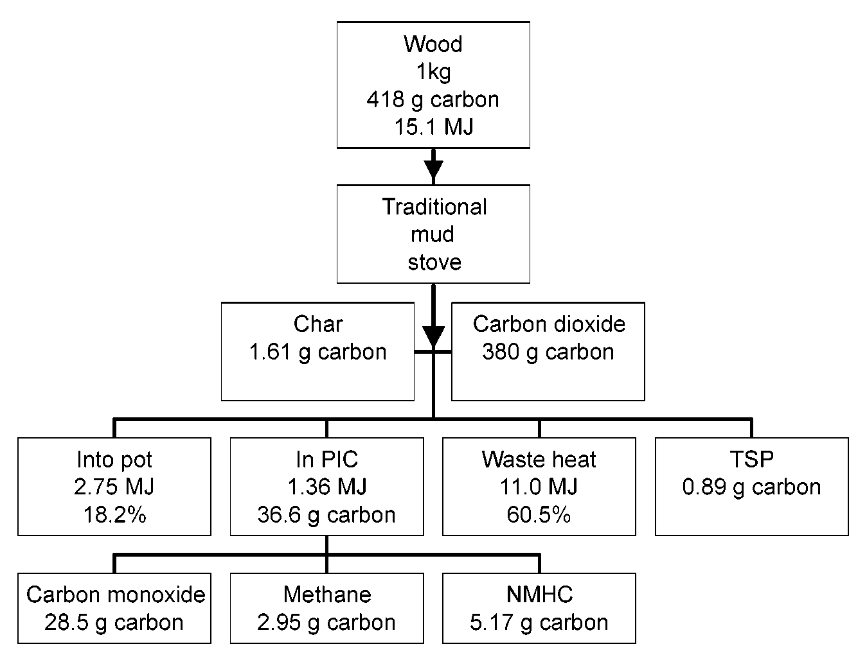
Putting some numbers on the carbon flows
Energy and carbon flows in an Indian mud chulha
From Smith et al. 2000
~90%
9%
7%
<<1%
< 1%
1%
Notes:
1.4 kg CO2 (about 90% impact)
0.114 kg CO2e as methane (about 10% impact)

Slide 13
Putting some numbers on the carbon flows (in CO2e)
Energy and carbon flows in an Indian mud chulha
From Smith et al. 2000
~ 90%
Proportions change if we account for regrowth
~ 10% wt’d by GWP
Notes:
1.4 kg CO2 (about 90% impact)
0.114 kg CO2e as methane (about 10% impact)

Slide 14
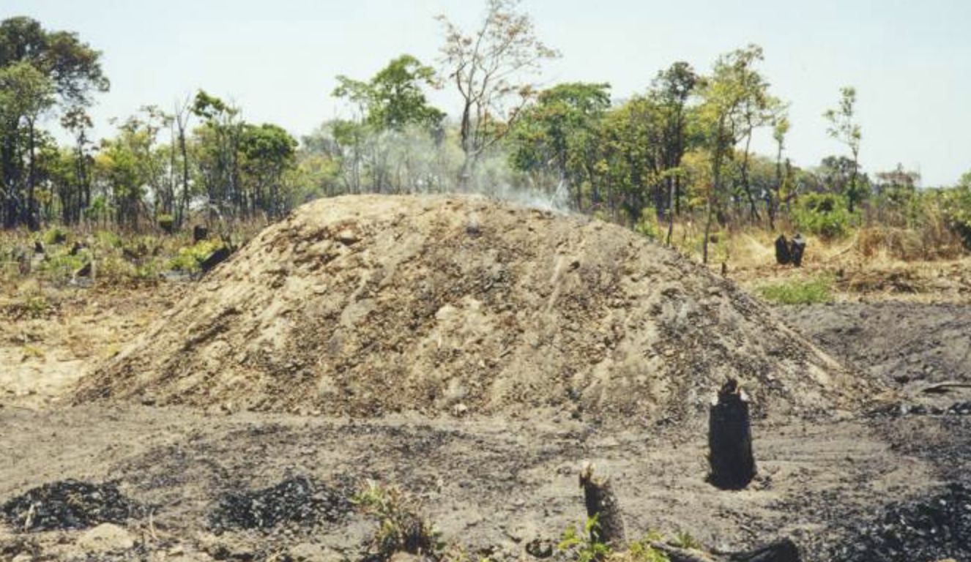
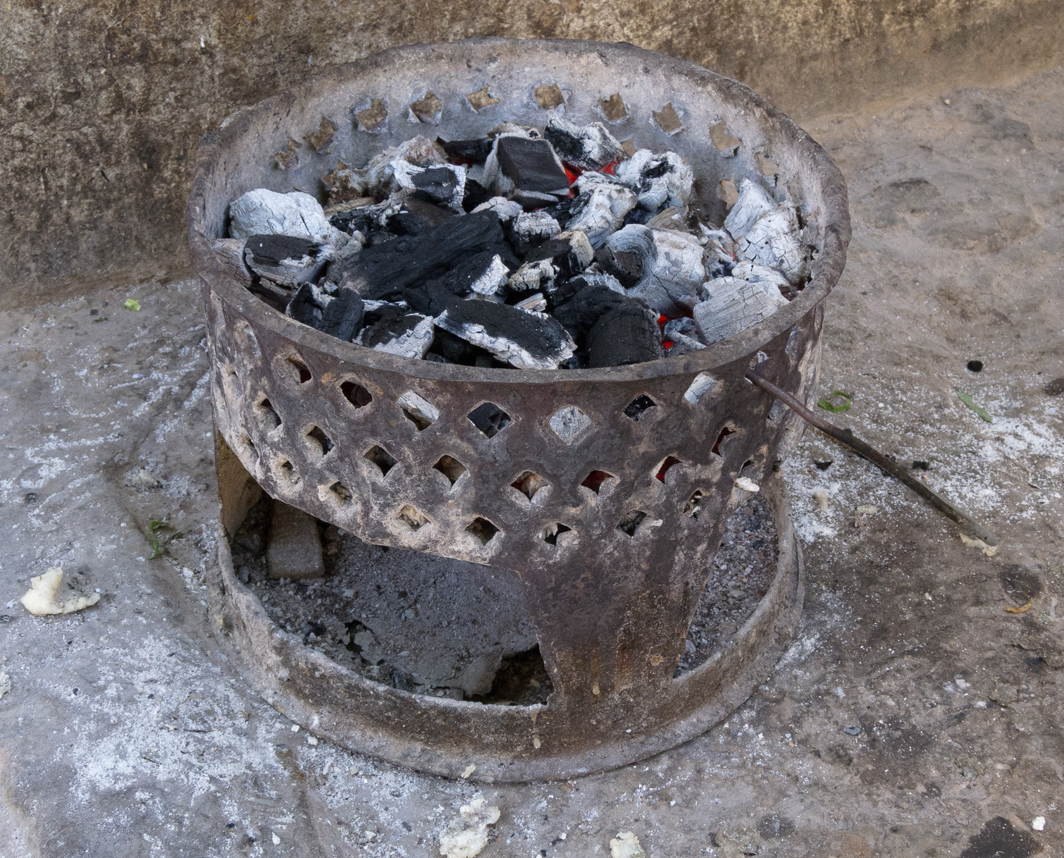
One kilo of charcoal looks different…
6 kg wood
2.8 kg carbon
108 MJ
Brands & condensables
~400 g carbon
Pyrolysis
Carbon dioxide
900 g carbon
Carbon monoxide
250 g carbon
Methane
60 g carbon
NMHC
300 g carbon
Particulates
70 g carbon
1 kg charcoal
800 g carbon
30MJ
Cooking
Carbon dioxide
700 g carbon
Carbon monoxide
60 g carbon
Methane
5 g carbon
NMHC
5 g carbon
Particulates
5 g carbon
Using one kilo of charcoal emits 5.9 kg CO₂ and 87 g of CH₄ (2.3 kg CO₂e)
(also depends on tree regrowth)
Notes:
5.9 kg CO2 (about 70% impact)
0.87 g CO2e as methane (about 30% impact)
Nearly 70% is from pyrolysis

Slide 15
An intervention in a Ugandan household (40%fNRB)
Rural wood users
2.5 tons of wood / year
1.7 tons CO2e / yr
An LPG intervention reduces fuel consumption by 50%
Reduces 0.9 t CO2e
Adds 0.3 t CO2e from LPG
Net change is –0.6 t CO2e
Urban charcoal users
750 kg charcoal / year (4.5 tons wood)
3.5 tons CO2e / yr
Reduces 1.8t CO2e
Adds 0.3 t CO2e from LPG
Net change is –1.5 t CO2e
Notes:
Assumptions:
People use 500 kg wood or 150 kg charc per yr
HH uses 156 ÷ 2 kg of LPG/yr (1 ÷ 2 cylinder/month)

Slide 16
Explanation of BURN fNRB method and differences with MoFuSS?

Slide 17
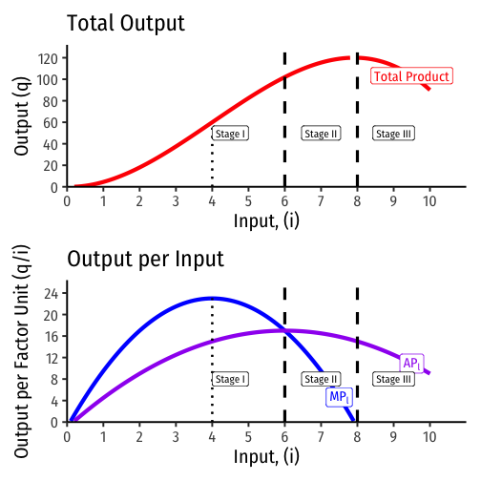
Marginal fNRB
What the heck are we talking about?
Common in Economics
The effect of a unit change in one variable on another variable
Utility, Cost/Revenue, Productivity
Output is a non-linear function of inputs like capital and labor (top graph)
An additional unit of input affects output differently depending on the quantity of inputs already being utilized (lower graph - blue line)
https://thoughtf20.classes.ryansafner.com/slides/3.2-slides#26

Slide 18
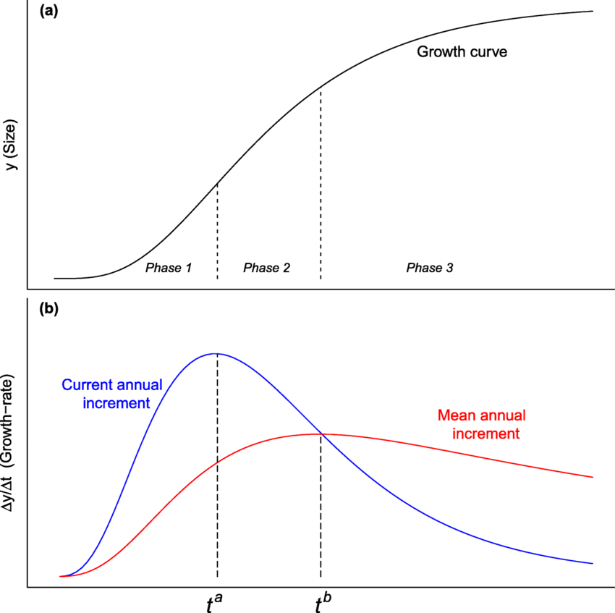

Marginal fNRB
How does this apply to trees?
“Output” is woody biomass
MP_{i} is Current Annual Increment (CAI)
Inputs are sunlight, nutrients, and the trees …
“leaves are the forest’s photosynthetic factory”
But its not a direct analogy
These plots show “time”, not inputs
We’re not directly interested the growth curve
We need to know how harvest leads to losses in stock
https://www.researchgate.net/publication/357163700_Growth_Equations_in_Forest_Research_Mathematical_Basis_and_Model_Similarities/figures?lo=1

Slide 19
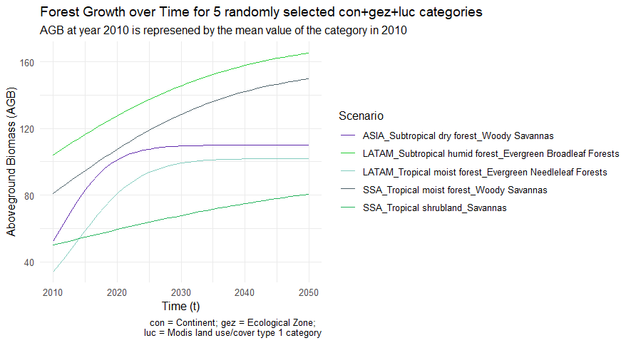
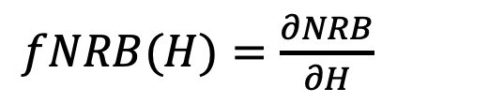
Marginal fNRB
Examples of growth functions used in different eco-regions
Things get more complicated
Each country we assess has dozens of growth functions distributed across thousands to millions of pixels
Harvest is very heterogenous
We’re using MoFuSS to “construct” a marginal fRNB function for each country:

Slide 20
Marginal fNRB
VERY preliminary results using Tanzania as a test case
We ran 10 simulations changing demand uniformly by ± 5, ± 10, ± 15, ± 25, & ± 50%
NRB as a function of wood harvest
fNRB and mfNRB as a function of wood harvest
mfNRB comes out 5-7% higher than fNRB

Slide 21
Marginal fNRB – next steps
Repeat in additional countries using uniform changes in demand
TZA is high fNRB, we’ll add a few others (e.g. MWI, SEN)
Low fNRB countries
Rapidly changing fuel mix (e.g. India, Kenya)
Examine the impact of non-uniform changes
Only fuelwood (mainly subsistence)
Only charcoal (fully commercial)
Specific admin units

Slide 22
Extra slides

Slide 23
Brief list of research on woodfuels and degradation
Ahrends et al (2010) “Predictable waves of sequential forest degradation and biodiversity loss spreading from an African city”
Hosonuma et al (2012) “An assessment of deforestation and forest degradation drivers in developing countries”
Ryan et al. (2014) “Quantifying the causes of deforestation and degradation…method and case study from central Mozambique”
McNicol et al (2018) “Carbon losses from deforestation and widespread degradation offset by extensive growth…”
Sedano et al (2016) “The impact of charcoal production on forest degradation: a case study in Tete, Mozambique”
Pearson et al. (2017) “Greenhouse gas emissions from tropical forest degradation: an underestimated source”

Slide 24
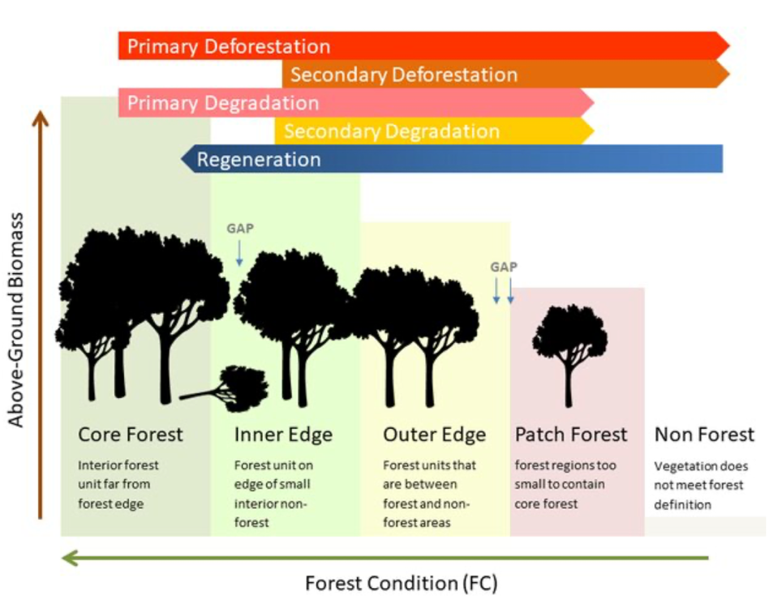
Definitions
Deforestation
The conversion of forest to another land use or the long-term reduction of tree canopy cover below a minimum threshold.
Degradation
Changes that negatively affect the structure or function of forests, woodlands, or stands of trees, lowering their capacity to supply products and/or services.
(both adapted from FAO)
From Shapiro et al. (2020)
Notes:
Deforestation:
Degradation:

Slide 25
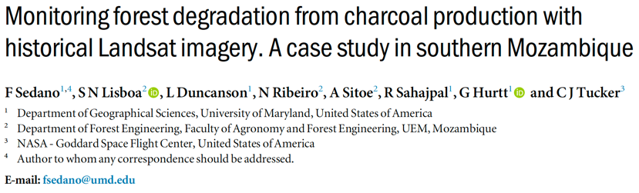
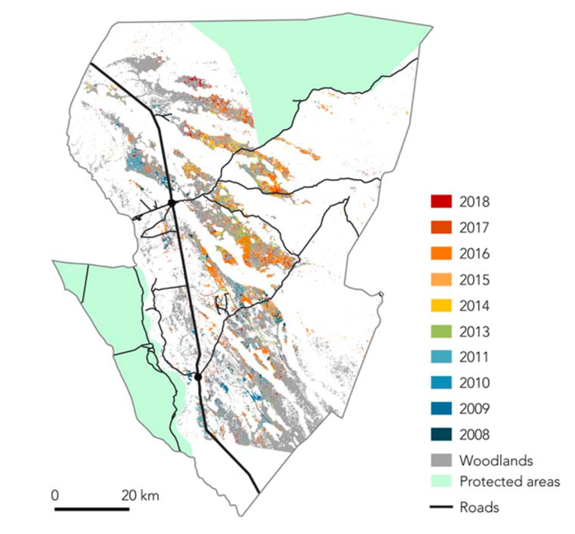
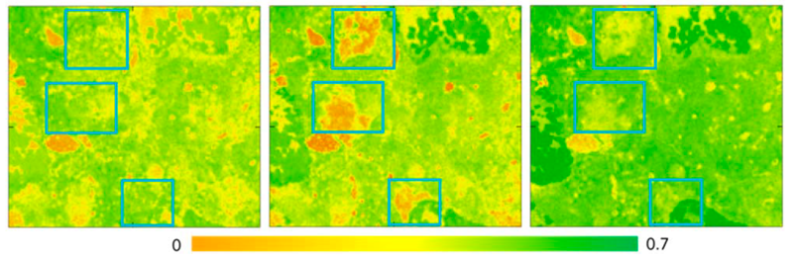
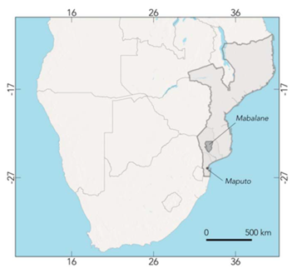
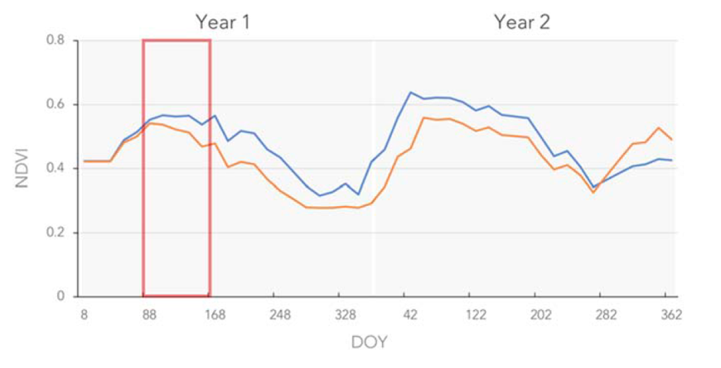
Example of charcoal-driven degradation…
Annual forest degradation from charcoal production (2008-2018)
NDVI images (top) and time series (bottom) in mopane woodlands comparing areas affected by charcoal production (blue squares) to unaffected areas over a 2-year period.
Notes:
NDVI – (Normalized difference vegetation index) quantifies vegetation health using near-infrared (which is reflected by vegetation) and red light (which is absorbed by vegetation). It is an indication of vegetation density and possible changes in plant health.

Slide 26
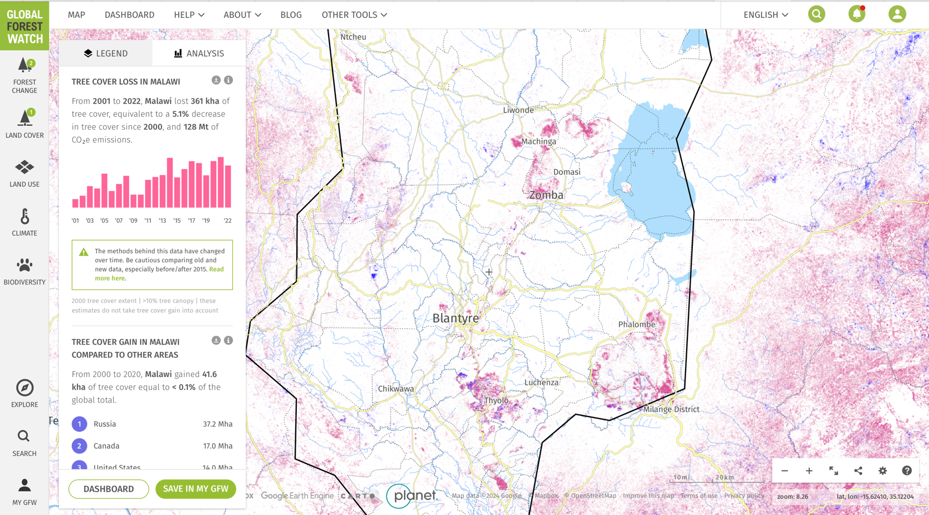
Yes, trees grow in SSA (data from LANDSAT)
https://www.globalforestwatch.org/map/country/MWI/

Slide 27
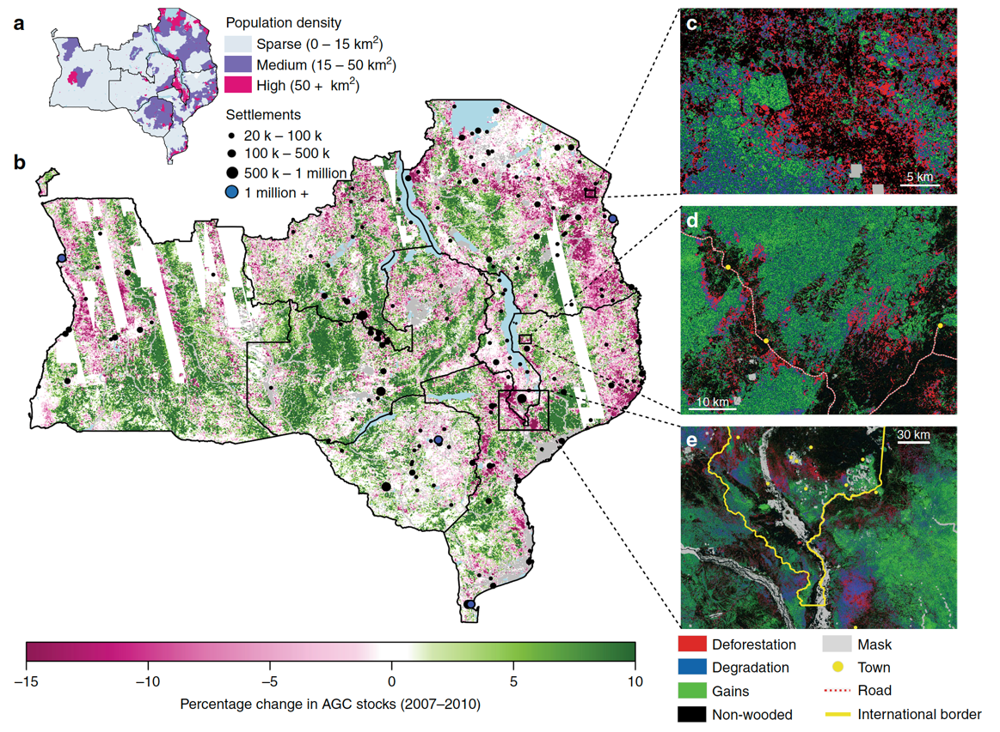
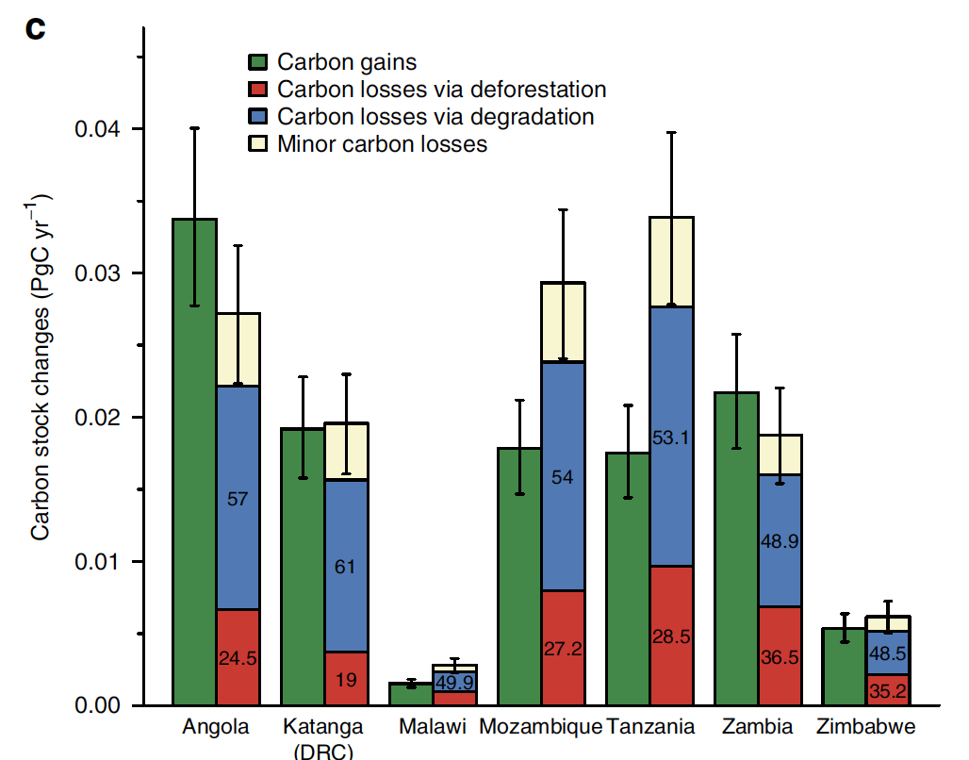
Yes, trees grow in SSA (data from ALOS-PALSAR)
Carbon stock changes due to deforestation, degradation and (re)growth, with the values is the losses bar showing the percentage contribution of deforestation and degradation to the total carbon losses . Error bars show the 95% confidence intervals (CIs) and represent for the total error on each bar (from https://www.nature.com/articles/s41467-018-05386-z).
Notes:
Radar imagery was obtained from the Phased Array L-Band Synthetic Aperture Radar sensor on-board JAXA’s Advanced Land Observation Satellite (ALOS-PALSAR). We use the 25 m horizontal-send vertical-receive (HV) polarisation mosaic product which provides annual maps of radar backscatter for 2007–201026 L-band HV backscatter is known to be sensitive to woody biomass density up to a saturation point of around 75 MgC ha⁻¹ and has been shown to be able to detect deforestation, degradation, and regrowth in savanna woodlands.

Slide 28
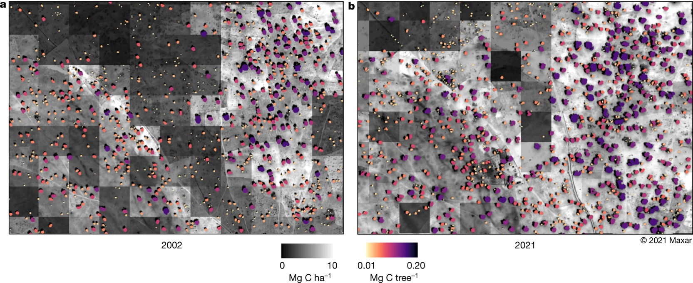
Yes, trees grow in SSA (data from MAXAR)
A 50-cm-scale image from 2002 (a) and a 50-cm-scale satellite image from 2021 (b) showing an agroforestry area at the same location. Tree cover has increased between 2002 and 2021 and the average carbon density of both areas was calculated and increased from 6 to 10 Mg ha⁻¹. A large number of trees grow on farmlands, keeping the soils fertile and reducing the need for fallow periods. The greyscale of the background images indicates the carbon density per hectare, whereas the colour scale shows the carbon content of individual trees. This is a good example of the tree restoration monitoring potential in our study area (from https://www.nature.com/articles/s41586-022-05653-6).
Notes:
67% increase in woody biomass stocks
326,523 Maxar multispectral images from the QuickBird-2, GeoEye-1, WorldView-2 and WorldView-3 satellites collected from 2002 to 2020 from November to March from 9.5° N to 24° N latitude within Universal Transverse Mercator (UTM) zones 28–37 for Africa

Slide 29
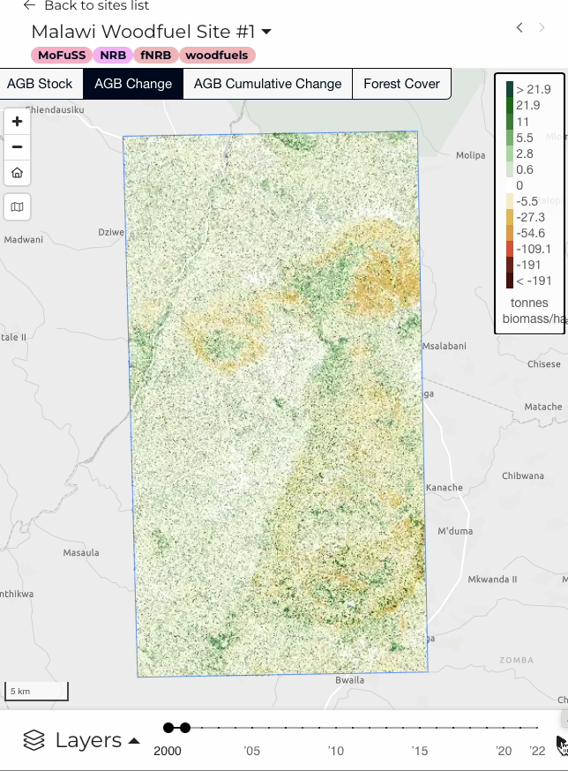
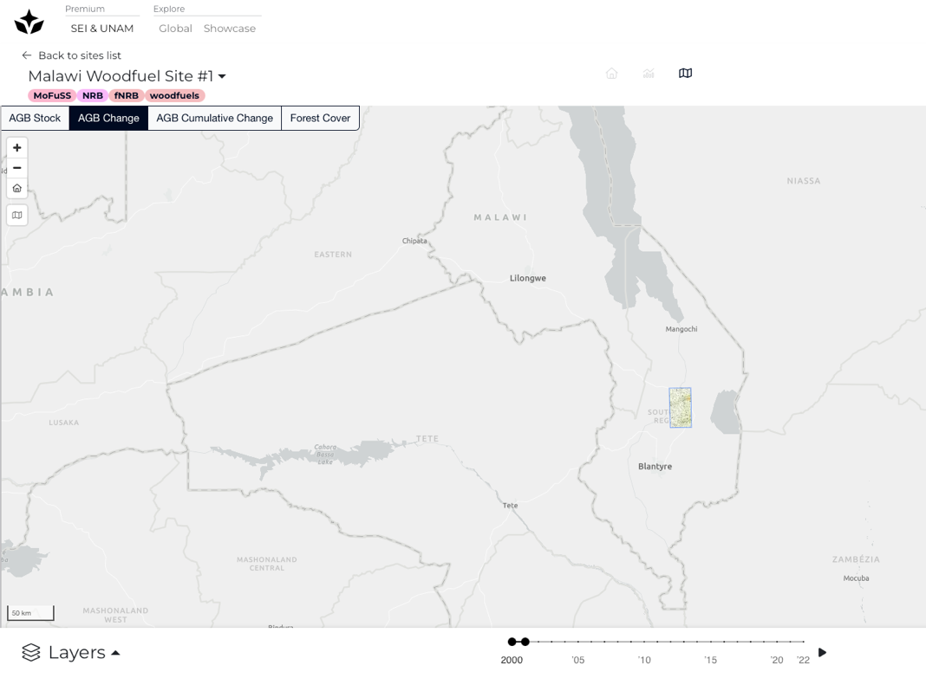

Slide 30
